Slide 1

COMP 520 - Compilers
Lecture 16 – Code/Data Path Analysis

Slide 2
Reminders
Midterm 2 on next Thursday, 4/11
WA3 due tonight
COMP 520: Compilers – S. Ali

Slide 3
Announcements
PA4- Make( Reg ridx, int mult, int disp, Reg r )
  This is probably the most difficult Make method
  Two ways around this:
    Don’t use [ridx*mult+disp] in your CodeGenerator
    Solve the mystery in the ModRM+SIB table
WA3
  rep stosq- “REP” is a prefix that repeats the subsequent instruction “STOSQ”. The documentation for REP will tell you what the end condition is. Assume DF=0 or 1, either is fine.
COMP 520: Compilers – S. Ali

Slide 4
Announcements (2)
PA4- Clarifications
Callee should clean the stack
  See ret imm16, where imm16 bytes are removed after returning.
If you want your own username on the test server, make a private Piazza post, and Eric or I will adduser you.
  Don’t need to do this, use the generic comp520 login otherwise.
  You do not get sudo permissions though, for the sanity of everyone involved.
COMP 520: Compilers – S. Ali

Slide 5
Announcements (3)
PA4- Clarifications
You are given mmap, which allocates a 4kb chunk.
Remember, your PA4 goal is to make the code work before you optimize, so just make everything a 4kb allocation even if the size isn’t 4kb.
Can change this later in PA5’s optional extra credit.
COMP 520: Compilers – S. Ali

Slide 6
Announcements (4)
PA4- Clarifications
Do not allocate objects on the stack.
Some tests check for this where too many objects on the stack will crash the program.
Lastly, you need to find out how to do sys_write. Use the given sys_mmap example.
  Enables System.out.println(int n);
COMP 520: Compilers – S. Ali

Slide 7

Compiler
Optimization
Dataflow Analysis
Code Analysis
Data Liveness
Expr Liveness
Register Minimalization
Multiple CodePath
Generation
TODAY
COMP 520: Compilers – S. Ali

Slide 8
Available Expressions / Expression Lifetime Analysis
Can also apply lifetime analysis to expressions, not just variables.
COMP 520: Compilers – S. Ali

Slide 9
Consider the following code:
s := a + b;
m := a * b;
while( m > a ) {
a := a + 1;
s := a + b;
}
COMP 520: Compilers – S. Ali

Slide 10
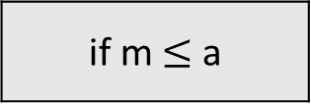
Construct the CFG
s := a + b
s := a + b;
m := a * b;
while( m > a ) {
a := a + 1;
s := a + b;
}
m := a * b
if m $≤$ a
a := a + 1
return
s := a + b
COMP 520: Compilers – S. Ali

Slide 11
When data is invalidated, so are all expressions utilizing that data.
s := a + b
s := a + b;
m := a * b;
while( m > a ) {
a := a + 1;
s := a + b;
}
{ a+b }
m := a * b
{ a+b, a*b }
if m $≤$ a
{ a+b, a*b }
{ a+b, a*b }
a := a + 1
return
???
s := a + b
COMP 520: Compilers – S. Ali

Slide 12
When data is invalidated, so are all expressions utilizing that data.
s := a + b
s := a + b;
m := a * b;
while( m > a ) {
a := a + 1;
s := a + b;
}
Note: we lost a*b here:
{ a+b }
m := a * b
{ a+b, a*b }
if m $≤$ a
{ a+b }
??
a := a + 1
return
{ }
s := a + b
{ a+b }
COMP 520: Compilers – S. Ali

Slide 13
When data is invalidated, so are all expressions utilizing that data.
s := a + b
s := a + b;
m := a * b;
while( m > a ) {
a := a + 1;
s := a + b;
}
{ a+b }
m := a * b
{ a+b, a*b }
if m $≤$ a
{ a+b }
{ a+b }
a := a + 1
return
{ }
s := a + b
{ a+b }
COMP 520: Compilers – S. Ali

Slide 14
Expression Liveness
Very useful so that an expression does not have to be re-evaluated.
Let’s look at that example earlier with one minor modification.
COMP 520: Compilers – S. Ali

Slide 15

No need to re-evaluate a+b, because s is an alias.
s := a + b
s := a + b;
m := a * b;
while( m > a ) {
a := a + 1;
s := a + b;
}
z := a + b;
{ a+b }
m := a * b
{ a+b, a*b }
if m $≤$ a
{ a+b }
{ a+b }
a := a + 1
z = a + b
Evaluate a+b?? NO!
{ }
s := a + b
return
{ a+b }
COMP 520: Compilers – S. Ali

Slide 16
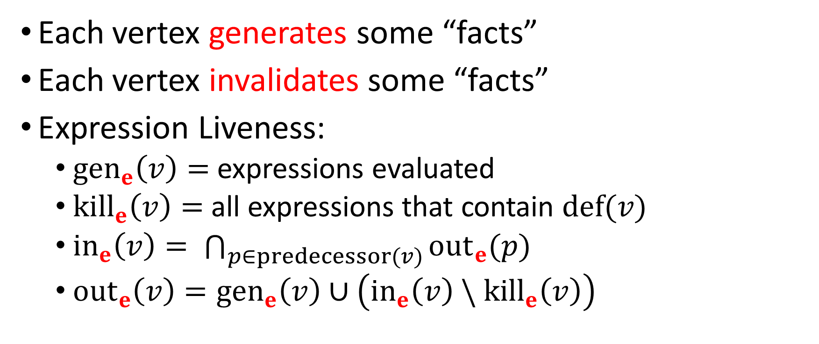
Formal Description: Expression Liveness
Each vertex generates some “facts”
Each vertex invalidates some “facts”
Expression Liveness:
  $gen_{e}\left(v\right)=$ expressions evaluated
  $kill_{e}\left(v\right)=$ all expressions that contain $def(v)$
  ${in}_{e}\left(v\right)= \bigcap_{p∈predecessor(v)}{{out}_{e}(p)}$
  ${out}_{e}\left(v\right)={gen}_{e}\left(v\right)∪\left({in}_{e}\left(v\right) \backslash {kill}_{e}\left(v\right)\right)$
COMP 520: Compilers – S. Ali

Slide 17
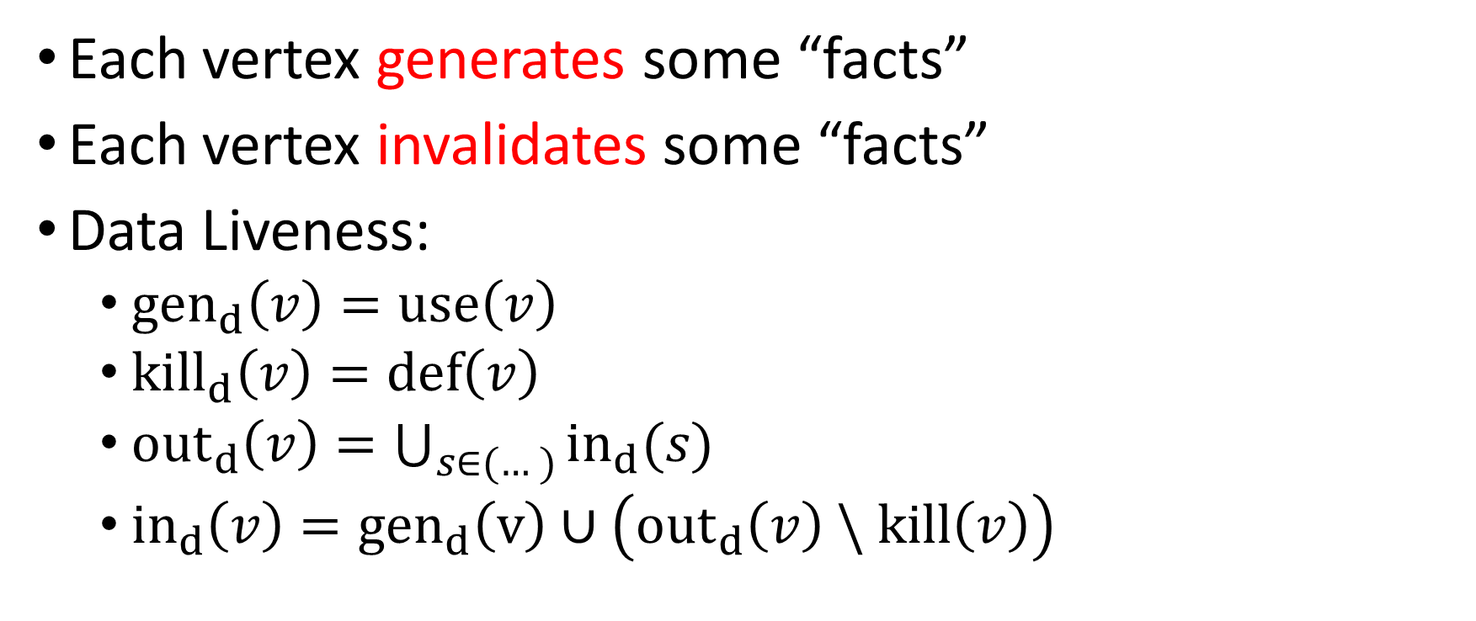
Another Description: Data Liveness
Each vertex generates some “facts”
Each vertex invalidates some “facts”
Data Liveness:
  $gen_{d}\left(v\right)=use\left(v\right)$
  $kill_{d}\left(v\right)=def\left(v\right)$
  ${out}_{d}\left(v\right)=\bigcup_{s∈(…)}{in_{d}(s)}$
  ${in}_{d}\left(v\right)={gen}_{d}\left(v\right)∪\left({out}_{d}\left(v\right) \backslash kill\left(v\right)\right)$
COMP 520: Compilers – S. Ali

Slide 18
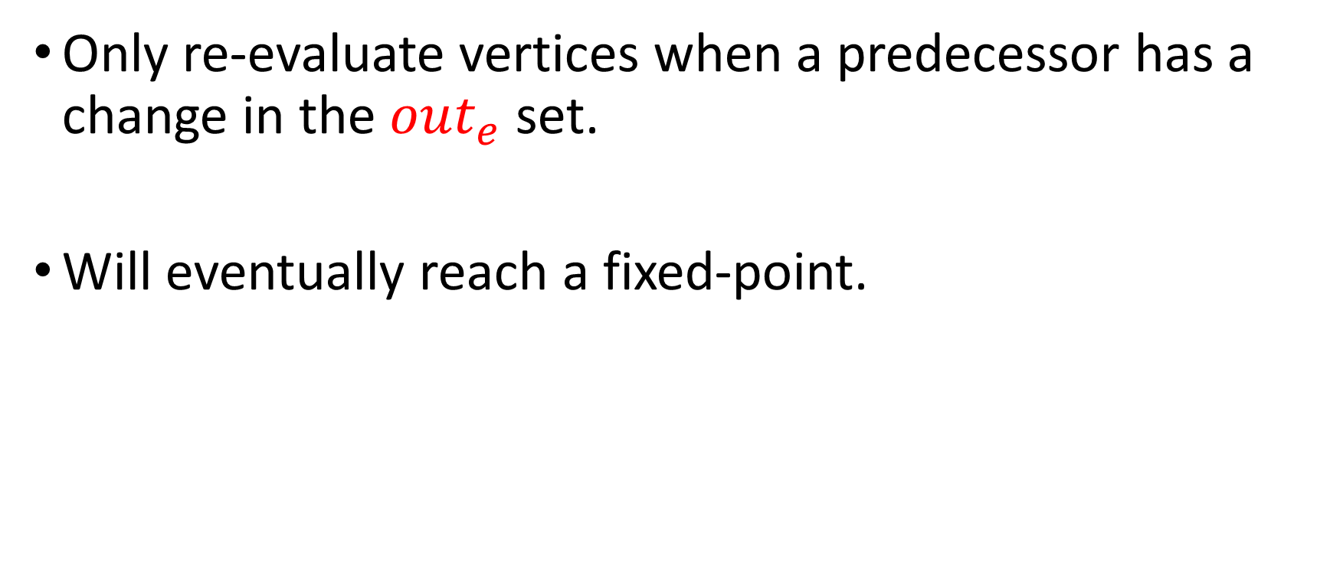
Termination in “Expression Liveness”
Only re-evaluate vertices when a predecessor has a change in the $out_{e}$ set.
Will eventually reach a fixed-point.
COMP 520: Compilers – S. Ali

Slide 19
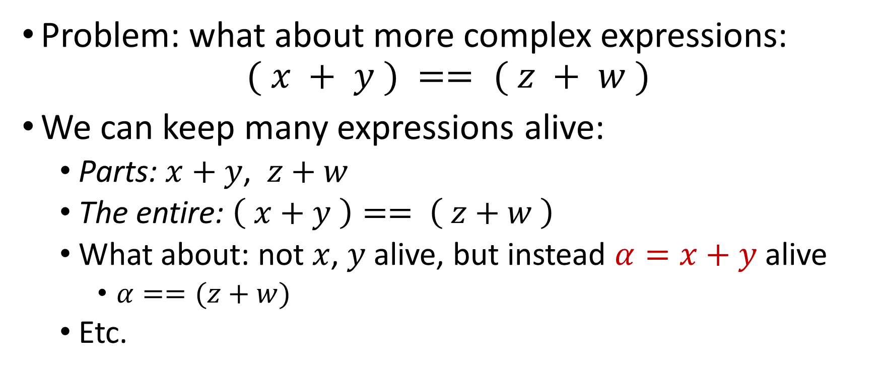
Not so simple…
Problem: what about more complex expressions:
$$( x + y ) == ( z + w )$$
We can keep many expressions alive:
  Parts: $x+y$, $z+w$
  The entire: $\left( x+y \right)== \left( z+w \right)$
  What about: not $x$, $y$ alive, but instead $α=x+y$ alive
    $α==(z+w)$
  Etc.
COMP 520: Compilers – S. Ali

Slide 20

Idea: Break up vertices
Break every expression into small constituent components. Generate extra code!
“( x + y ) == ( z + w )” $⇒$ { x+y, z+w }
Original | Generate Code
c := (x+y) == (z+w) | a := x+y
 | b := z+w
d := z+w | c := (x+y)==(z+w)
 | d := z+w
Some part of the expression is used later
return c+d
COMP 520: Compilers – S. Ali

Slide 21
Apply Expression Liveness Analysis
Replace expressions with aliased expressions
Original | Generate Code | Apply Aliases
c := (x+y) == (z+w) | a := x+y | a := x+y
 | b := z+w | b := z+w
d := z+w | c := (x+y)==(z+w) | c := a==b
 | d := z+w | d := b
return c+d
COMP 520: Compilers – S. Ali

Slide 22
Apply Data Liveness Analysis
Reuse variable names
Original | Generate Code | Apply Aliases | x | y | z | w | a | b | c | d | New Data Aliases
c := (x+y) == (z+w) | a := x+y | a := x+y
 | b := z+w | b := z+w
d := z+w | c := (x+y)==(z+w) | c := a==b
 | d := z+w | d := b
return c+d
COMP 520: Compilers – S. Ali

Slide 23
Apply Data Liveness Analysis
Can eliminate redundant operations
Original | Generate Code | Apply Aliases | x | y | z | w | a | b | c | d | New Data Aliases
c := (x+y) == (z+w) | a := x+y | a := x+y |  |  |  |  |  |  |  |  | x := x+y
 | b := z+w | b := z+w |  |  |  |  |  |  |  |  | y := z+w
d := z+w | c := (x+y)==(z+w) | c := a==b |  |  |  |  |  |  |  |  | x := x==y
 | d := z+w | d := b |  |  |  |  |  |  |  |  | y := y
x
y
z
w
x
y
x
y
return c+d
x := x+y
ret x
x
COMP 520: Compilers – S. Ali

Slide 24
Review
Data Liveness Analysis:
  Reduces the amount of data you need in memory at any given time
  Somewhat related to minimizing register usage (minimizing
  registers can be done after data+expression liveness)
Expression Liveness Analysis:
  Can eliminate the need to re-process expressions
Combined:
  They can eliminate instructions and reduce memory consumption.
  Without the other, significantly less effective.
COMP 520: Compilers – S. Ali

Slide 25
More Optimization?
Statements | # live
x := x+y | 4 (x,y,z,w)
y := z+w | 4 (x,y,z,w)
x := x==y | 2 (x,y)
x := x+y | 2 (x,y)
ret x | 1 (x)
Does that mean we
need 4 registers?
COMP 520: Compilers – S. Ali

Slide 26
More Optimization?
Does that mean we
need 4 registers?
Nope! More optimization possible
that will be related to the target
architecture.
Statements | # live
x := x+y | 4 (x,y,z,w)
y := z+w | 4 (x,y,z,w)
x := x==y | 2 (x,y)
x := x+y | 2 (x,y)
ret x | 1 (x)
COMP 520: Compilers – S. Ali

Slide 27
Register Minimalization is not
Dataflow/Expression Analysis
Statements | # live | X64 | # live
x := x+y | 4 (x,y,z,w) | mov rax,[x] | 1 (rax)
 |  | add rax,[y] | 1 (rax)
y := z+w | 4 (x,y,z,w) | mov rcx,[z] | 2 (rax,rcx)
 |  | add rcx,[w] | 2 (rax,rcx)
x := x==y | 2 (x,y) | cmp rax,rcx | 2 (rax,rcx)
 |  | xor rax,rax | 2 (rax,rcx)
 |  | sete al | 2 (rax,rcx)
x := x+y | 2 (x,y) | add rax,rcx | 2 (rax,rcx)
ret x | 1 (x) | ret | 1 (rax)
Only needed two registers.
Why? Because x64 can do “load memory” operations inside of instructions!
COMP 520: Compilers – S. Ali

Slide 28
Optimized Code Generation – AST Reprocessing
COMP 520: Compilers – S. Ali

Slide 29
You can find optimizations before you reach code generation.
AST-level optimizations can become an “Optimization” AST traversal phase before CodeGeneration
Syntactic
Contextual
Optimization
Code Gen
COMP 520: Compilers – S. Ali

Slide 30
Expression Optimization
Developer writes the code:
// This page needs to start 3 full pages
// after base address
int somePg = ( 3 * 4096 ) + 0x80000000;
COMP 520: Compilers – S. Ali

Slide 31
..So we generate the code
Input Code
Generated Code
int somePg = ( 3 * 4096 )
+ 0x80000000;
mov rax,4096
imul 3 # pseudocode
add rax,0x80000000
mov dword [somePg],rax
Anyone have any problems with this?
COMP 520: Compilers – S. Ali

Slide 32
Fix the AST
Input Code
Create visitor
int somePg = ( 3 * 4096 )
+ 0x80000000;
Input AST
BinExpr (+)
BinExpr (*)
3
4096
LiteralExpr (0x80000000)
“Expression Pre-evaluator Visitor”
Visit BinExpr / UnaryExpr
Visit sub-expressions.
If all expressions are LiteralExpr,
Return a new LiteralExpr
Returned LiteralExpr pre-evaluates constant operations.
COMP 520: Compilers – S. Ali

Slide 33
Fix the AST (Example)
Input Code
Output AST
int somePg = ( 3 * 4096 )
+ 0x80000000;
Input AST
BinExpr (+)
BinExpr (*)
3
4096
LiteralExpr (0x80000000)
First Converge
BinExpr (+)
LiteralExpr (12288)
LiteralExpr (0x80000000)
COMP 520: Compilers – S. Ali

Slide 34
Fix the AST (Example 2)
Input Code
Output AST
int somePg = ( 3 * 4096 )
+ 0x80000000;
Input AST
BinExpr (+)
BinExpr (*)
3
4096
LiteralExpr (0x80000000)
First Converge
BinExpr (+)
LiteralExpr (12288)
LiteralExpr (0x80000000)
Second Converge
LiteralExpr(0x80003000)
COMP 520: Compilers – S. Ali

Slide 35
Optimization Visitor Model (Finish)
Each visit returns an AST
Most of them return themselves.
Otherwise, return a new optimized AST.
E.g., BinExpr.LHS = BinExpr.LHS.visit(…);
BinExpr.RHS = BinExpr.RHS.visit(…);
… Now are LHS and RHS instanceof LiteralExpr?
… If so, return new LiteralExpr( ... “LHS op RHS” … );
COMP 520: Compilers – S. Ali

Slide 36
Intel C Compiler- Case Study
An example as an intro to multiple code-path generation.
COMP 520: Compilers – S. Ali

Slide 37
“Genuine Intel”
This study is an interesting intersection of topics.
Things to keep in mind:
  x86 belongs to Intel
  x64 (the 64-bit extension) was developed by AMD, was so popular that Intel was forced to adopt it (in lieu of IA64)
  AMD has a license to make x86/x64 processors
Exactly how fair does Intel have to be towards its competition?
COMP 520: Compilers – S. Ali

Slide 38
ICC Generates this code
cpuid
cmp ebx, 0x756E6547
jne OtherLoc
cmp edx, 0x49656E69
jne OtherLoc
cmp ecx, 0x6C65746E
jne OtherLoc
Problem Statement:
This code looks nothing like the input program’s source code.
COMP 520: Compilers – S. Ali

Slide 39
Consider the code:
int a[100], b[100], c[100];
… // Initialize Data
for( int i = 0; i < 100; ++i ) {
c[i] = a[i] + b[i];
}
COMP 520: Compilers – S. Ali

Slide 40
Generate Simple Code
Original
x64
int a[100], b[100], c[100];
… // Initialize Data
for( int i = 0; i < 100; ++i ) {
c[i] = a[i] + b[i];
}
# Assume data initialized already
# int = 4 bytes long
# From this line, generate code
COMP 520: Compilers – S. Ali

Slide 41
Option 1 (Initialization)
Original
x64
int a[100], b[100], c[100];
… // Initialize Data
for( int i = 0; i < 100; ++i ) {
c[i] = a[i] + b[i];
}
# From this line, generate code
mov rax,0 # Initialize i=0
loopStart: cmp rax,100 # compare, i to 100
jge loopEnd # if i >= 100, end loop
mov rdx, [a+rax*4] # rdx= a[i]
add rdx, [b+rax*4] # rdx += b[i]
mov [c+rax*4],rdx # c[i] = rdx
inc rax # ++i
jmp loopStart # loop
loopEnd:
COMP 520: Compilers – S. Ali

Slide 42
Option 1 (Condition)
Original
x64
int a[100], b[100], c[100];
… // Initialize Data
for( int i = 0; i < 100; ++i ) {
c[i] = a[i] + b[i];
}
# From this line, generate code
mov rax,0 # Initialize i=0
loopStart: cmp rax,100 # compare, i to 100
jge loopEnd # if i >= 100, end loop
mov rdx, [a+rax*4] # rdx= a[i]
add rdx, [b+rax*4] # rdx += b[i]
mov [c+rax*4],rdx # c[i] = rdx
inc rax # ++i
jmp loopStart # loop
loopEnd:
COMP 520: Compilers – S. Ali

Slide 43
Option 1 (Body)
Original
x64
int a[100], b[100], c[100];
… // Initialize Data
for( int i = 0; i < 100; ++i ) {
c[i] = a[i] + b[i];
}
# From this line, generate code
mov rax,0 # Initialize i=0
loopStart: cmp rax,100 # compare, i to 100
jge loopEnd # if i >= 100, end loop
mov rdx, [a+rax*4] # rdx= a[i]
add rdx, [b+rax*4] # rdx += b[i]
mov [c+rax*4],rdx # c[i] = rdx
inc rax # ++i
jmp loopStart # loop
loopEnd:
COMP 520: Compilers – S. Ali

Slide 44
Option 1 (Incremental)
Original
x64
int a[100], b[100], c[100];
… // Initialize Data
for( int i = 0; i < 100; ++i ) {
c[i] = a[i] + b[i];
}
# From this line, generate code
mov rax,0 # Initialize i=0
loopStart: cmp rax,100 # compare, i to 100
jge loopEnd # if i >= 100, end loop
mov rdx, [a+rax*4] # rdx= a[i]
add rdx, [b+rax*4] # rdx += b[i]
mov [c+rax*4],rdx # c[i] = rdx
inc rax # ++i
jmp loopStart # loop
loopEnd:
COMP 520: Compilers – S. Ali

Slide 45
Observation 1
Each loop has no dependency on the previous loop
for( int i = 0; i < 100; ++i ) {
c[i] = a[i] + b[i];
}
COMP 520: Compilers – S. Ali

Slide 46
Option 2
Original
cld
mov rcx,100
lea rdi,[c]
lea rsi,[a]
rep movsd
mov rax,0
int a[100], b[100], c[100];
… // Initialize Data
for( int i = 0; i < 100; ++i ) {
c[i] = a[i] + b[i];
}
startLoop: cmp rax,100
jge endLoop
mov rdx,[b+rax*4]
add [c+rax*4],rdx
inc rax
jmp startLoop
endLoop:
COMP 520: Compilers – S. Ali

Slide 47
Option 2 – Loop Comparison
Option 1
loopStart: cmp rax,100 # compare, i to 100
jge loopEnd # if i >= 100, end loop
mov rdx, [a+rax*4] # rdx= a[i]
add rdx, [b+rax*4] # rdx += b[i]
mov [c+rax*4],rdx # c[i] = rdx
inc rax # ++i
jmp loopStart # loop
loopEnd:
Option 2
startLoop: cmp rax,100
jge endLoop
mov rdx,[b+rax*4]
add [c+rax*4],rdx
inc rax
jmp startLoop
endLoop:
One less instruction
COMP 520: Compilers – S. Ali

Slide 48
Option 2 – Initialization Comparison
Option 1
mov rax,0 # Initialize i=0
Option 2
cld # Set DF=0
mov rcx,100
lea rdi,[c]
lea rsi,[a]
rep movsd # store all of [a] into [c]
mov rax,0 # Initialize i=0
Is 1 or 2 always better than the other?
COMP 520: Compilers – S. Ali

Slide 49
What is better?
Depends on how fast rep movsd works.
Instead, consider an even more optimized vectorized instructions, like AVX.
VEX.128.66.0F.WIG FE VPADDD
  Does 3 additions in one, if the loop was only 3 integers, could do the entire loop in one instruction.
COMP 520: Compilers – S. Ali

Slide 50
Intel C Compiler
Optimization can rewrite code, but what if I take it a step further?
How about this:
for( int i = 0; i < 100; ++i )
d[i] = s[i];
COMP 520: Compilers – S. Ali

Slide 51
Intel C Compiler
No AMD Allowed
How about this:
for( int i = 0; i < 100; ++i )
d[i] = s[i];
mov rcx,100
if( “IntelProcessor” ) {
lea rsi,[s]
lea rdi,[d]
rep movsd
} else {
Do loop like option 1
}
COMPILER REWRITES
COMP 520: Compilers – S. Ali

Slide 52
Can make it worse!
If( “IntelProcessor” ) {
// do optimized code
} else {
// don’t even copy integers (4 bytes)
// copy ONE BYTE AT A TIME
for(…) { … mov [rdi+0], al
mov [rdi+1], ah
mov [rdi+2], cl
mov [rdi+3], ch … }
}
COMP 520: Compilers – S. Ali

Slide 53

People even make patchers…
As a part of the development process, when code is compiled using ICC…
Use a tool as a part of the build process to always patch out “if( Intel )” checks
COMP 520: Compilers – S. Ali

Slide 54
Largely patched now in ICC
…or is it?
But this gives us some excellent ideas on our own compiler project!
What if we can optimize for certain scenarios during runtime?
(Even if those scenarios don’t always happen!)
COMP 520: Compilers – S. Ali

Slide 55
ICC Generates this code
cpuid # Get CPU info
cmp ebx, 0x756E6547 # “Genu”
jne OtherLoc
cmp edx, 0x49656E69 # “ineI”
jne OtherLoc
cmp ecx, 0x6C65746E # “ntel”
jne OtherLoc
COMP 520: Compilers – S. Ali

Slide 56
Multiple Code Path Generation
COMP 520: Compilers – S. Ali

Slide 57
Round up to the nearest multiple of 8
Take a moment, and think about the code needed to round an integer, x, to the nearest multiple of 8
COMP 520: Compilers – S. Ali

Slide 58
Round up to the nearest multiple of 8
Take a moment, and think about the code needed to round an integer, x, to the nearest multiple of 8
while( ( x % 8 ) != 0 )
++x;
COMP 520: Compilers – S. Ali

Slide 59
Now try nearest multiple of “y”
Not a big change
while( ( x % y ) != 0 )
++x;
COMP 520: Compilers – S. Ali

Slide 60
Rounding up to a power of 2
Earlier example (to the next multiple of 8)
Analyze the following:
add [x],7 # x += 7
and [x],~7 # x &= 0xFFFFFFF8 (32-bit sign extended)
What does this code accomplish?
COMP 520: Compilers – S. Ali

Slide 61
So let’s rewrite the second example
if( __popcnt(y) == 1 && y > 0 ) {
c = y-1; // Optimized Code
x = ( x + c ) & ~c; // Not always faster
} else {
while( (x % y) != 0 ) // General Code
++x;
}
COMP 520: Compilers – S. Ali

Slide 62
Loop Unrolling
Let’s try to handle some cases of “small iterations are still faster”
COMP 520: Compilers – S. Ali

Slide 63
Compiler cleans up the mess
Bad Code
Clean Code
printf(“\t”);
printf(“\t”);
printf(“\t”);
printf(“\t”);
for( int i = 0; i < 4; ++i )
printf(“\t”);
COMP 520: Compilers – S. Ali

Slide 64
Compiler cleans up the mess
Bad Faster Code
Clean Inefficient Code
printf(“\t”);
printf(“\t”);
printf(“\t”);
printf(“\t”);
for( int i = 0; i < 4; ++i )
printf(“\t”);
COMP 520: Compilers – S. Ali

Slide 65
From Dataflow Analysis
Can track the lifetime of variables.
This also means we can simulate the range of variables.
This type of analysis is expensive
  Idea: simulate only variables that are used in conditions where the variable’s lifetime is not easily invalidated.
COMP 520: Compilers – S. Ali

Slide 66
Input CFG
int x = 4;
Observation: lifetime of condition “x” is easily analyzable.
Loop is bounded, unroll the loop
while( i < x )
printf(“\t”); ++i;
jmp
COMP 520: Compilers – S. Ali

Slide 67
Output Code
push “\t\0”
call [printf]
call [printf]
call [printf]
call [printf]
add rsp,8
int x = 4;
Way better than having a bunch of condition jumps, comparison statements, etc.
while( i < x )
printf(“\t”); ++i;
jmp
COMP 520: Compilers – S. Ali

Slide 68

Formally, this is the problem
$f\left(n\right)∈O\left(g\left(n\right)\right)≡∀n:n≥N∷f\left(n\right)≤g(n)$
We can optimize around the scenario $n<N$ in the compiler’s generated code.
COMP 520: Compilers – S. Ali

Slide 69
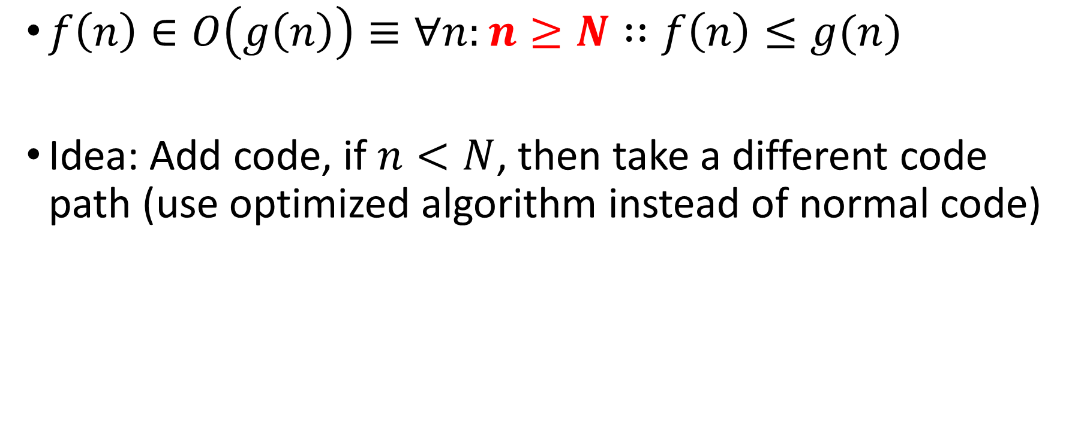
Formally, this is the problem
$f\left(n\right)∈O\left(g\left(n\right)\right)≡∀n:n≥N∷f\left(n\right)≤g(n)$
Idea: Add code, if $n<N$, then take a different code path (use optimized algorithm instead of normal code)
COMP 520: Compilers – S. Ali

Slide 70
How to Apply Multiple Code Paths
COMP 520: Compilers – S. Ali

Slide 71
Check Dataflow Analysis
Is there a memory dependency on the previous loop?
for( int i = 0; i < 100; ++i )
d[i] = s[i];
In: s[i]
d[i] = s[i]
Def: d[i]
No i-1 or i+1, can apply code
generation optimizations
COMP 520: Compilers – S. Ali

Slide 72
Check Dataflow Analysis (2)
Is there a memory dependency on the previous loop?
for( int i = 0; i < 100; ++i )
d[i] = s[i];
Use: rep movsd
In: s[i]
d[i] = s[i]
Def: d[i]
No i-1 or i+1, can apply code
generation optimizations
COMP 520: Compilers – S. Ali

Slide 73
Check Dataflow Analysis (3)
Is there a non-array dependency in every loop?
f = 0;
for( int i = 0; i < 100; ++i )
d[i] = f;
Use: rep stosd
In: f
d[i] = f
Def: d[i]
Dependency is on single
memory location
COMP 520: Compilers – S. Ali

Slide 74
Optimization – Your imagination is the limit
COMP 520: Compilers – S. Ali

Slide 75
Consider the following code:
int someFn() {
…
return code;
}
void mainFn() {
int x = someFn();
printf(“%d\n”,x);
}
COMP 520: Compilers – S. Ali

Slide 76
Consider the following code:
int someFn() {
…
return code;
}
void mainFn() {
int x = someFn();
printf(“%d\n”,x);
}
CALL
someFn
RETURN
main
main
COMP 520: Compilers – S. Ali

Slide 77
CALL
someFn
RETURN
main
ICC did the craziest optimization:
int someFn() {
…
return code;
}
void mainFn() {
int x = someFn();
printf(“%d\n”,x);
}
main
someFn
NEW main
No Return!
Old main
COMP 520: Compilers – S. Ali

Slide 78
Combined into one
continuous function
Old Code
CALL
someFn
RETURN
NEW main
main
main
Old main
COMP 520: Compilers – S. Ali

Slide 79
Ideas?
How can we create such optimizations?
Combined into one
continuous function
Old Code
CALL
someFn
RETURN
NEW main
main
main
Old main
COMP 520: Compilers – S. Ali

Slide 80
Inline operations
Compiler can detect “method was only used once”, instead of generating “push, call, return, pop”, just take the method’s code and place it where it is used.
Apply a translation to ParameterDecl to map to local variables.
COMP 520: Compilers – S. Ali

Slide 81
Have a great weekend!
Work on PA4, get some experience for the Midterm
Midterm next week.
WA3 due tonight.
COMP 520: Compilers – S. Ali

Slide 82
End

Slide 83
COMP 520: Compilers – S. Ali

Slide 84
COMP 520: Compilers – S. Ali

Slide 85
COMP 520: Compilers – S. Ali

Slide 86
COMP 520: Compilers – S. Ali

